Slide 1
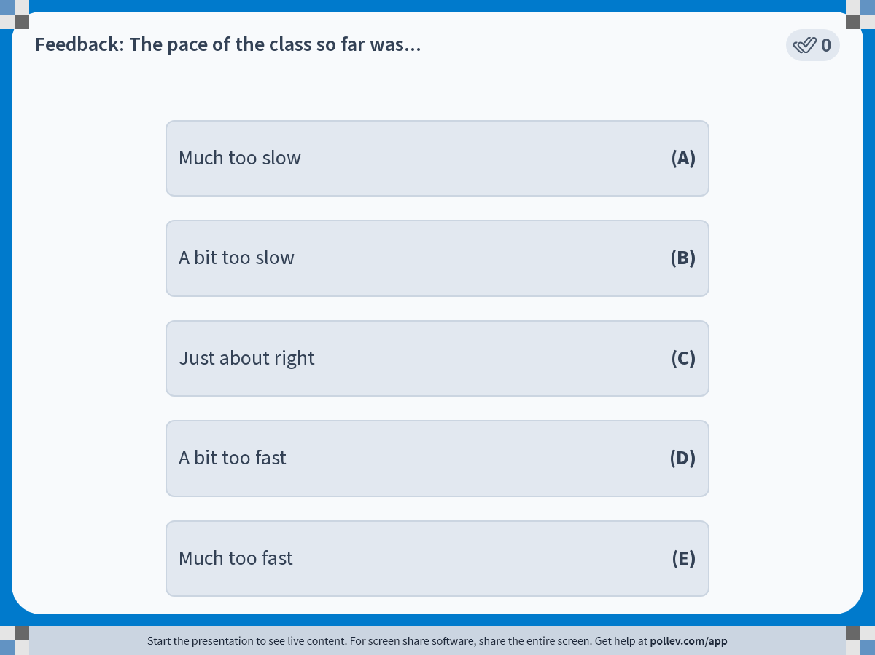
Notes:
Poll Title: Do not modify the notes in this section to avoid tampering with the Poll Everywhere activity. More info at polleverywhere.com/support Feedback: The pace of the class so far was... https://www.polleverywhere.com/multiple_choice_polls/OefYDOQ3h2PyhOWsk1j61?display_state=instructions&activity_state=opened&state=opened&flow=Engagement&onscreen=persist

Slide 2
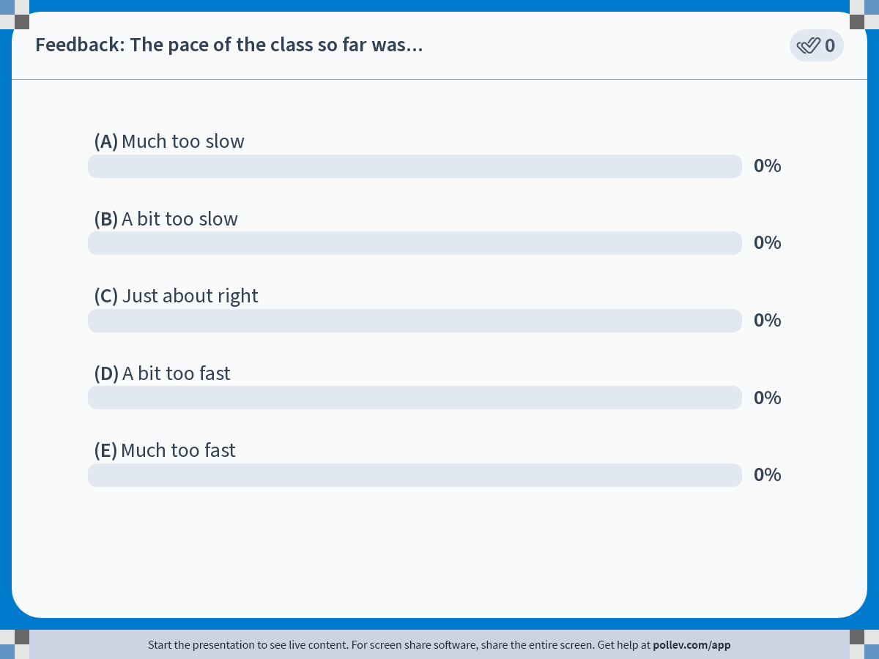
Notes:
Poll Title: Do not modify the notes in this section to avoid tampering with the Poll Everywhere activity. More info at polleverywhere.com/support Feedback: The pace of the class so far was... https://www.polleverywhere.com/multiple_choice_polls/OefYDOQ3h2PyhOWsk1j61?display_state=chart&activity_state=opened&state=opened&flow=Engagement&onscreen=persist

Slide 3
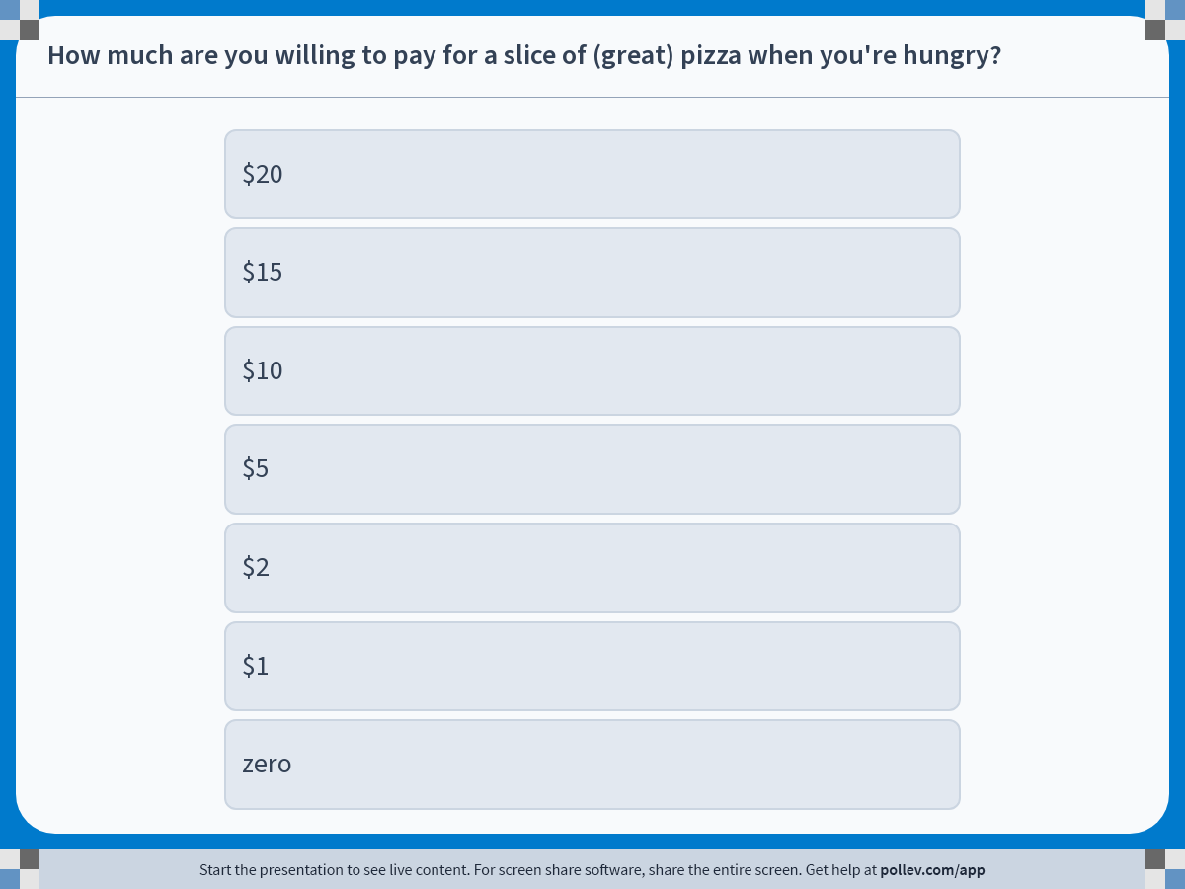
Notes:
Poll Title: Do not modify the notes in this section to avoid tampering with the Poll Everywhere activity. More info at polleverywhere.com/support How much are you willing to pay for a slice of (great) pizza when you're hungry? https://www.polleverywhere.com/multiple_choice_polls/UmpbBmwWBx0JnKXa5CZy6?display_state=instructions&activity_state=opened&state=opened&flow=Engagement&onscreen=persist

Slide 4
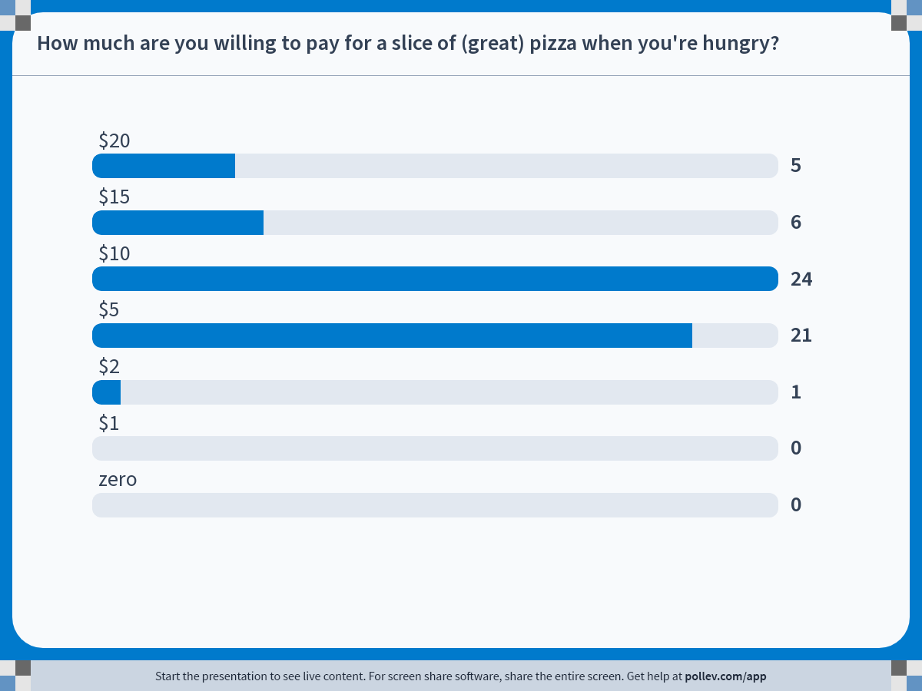
Notes:
Poll Title: Do not modify the notes in this section to avoid tampering with the Poll Everywhere activity. More info at polleverywhere.com/support How much are you willing to pay for a slice of (great) pizza when you're hungry? https://www.polleverywhere.com/multiple_choice_polls/UmpbBmwWBx0JnKXa5CZy6?display_state=chart&activity_state=opened&state=opened&flow=Engagement&onscreen=persist

Slide 5
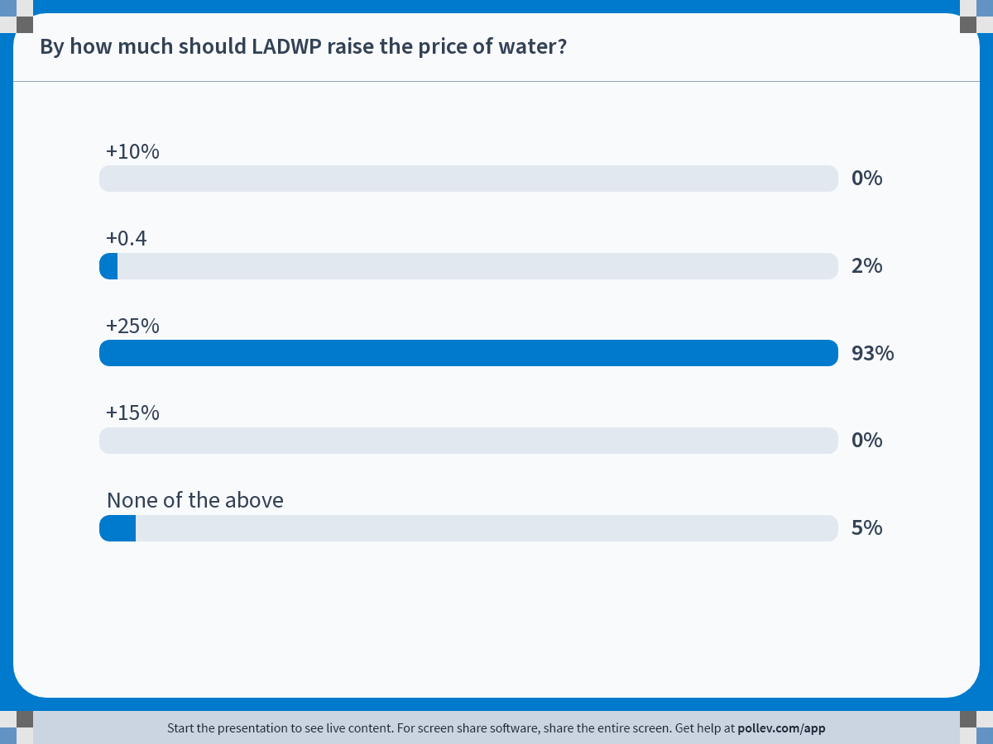
Notes:
Poll Title: Do not modify the notes in this section to avoid tampering with the Poll Everywhere activity. More info at polleverywhere.com/support By how much should LADWP raise the price of water? https://www.polleverywhere.com/multiple_choice_polls/ekzOwtuiEFxilIUOhjrKr?display_state=chart&activity_state=opened&state=opened&flow=Engagement&onscreen=persist

Slide 6
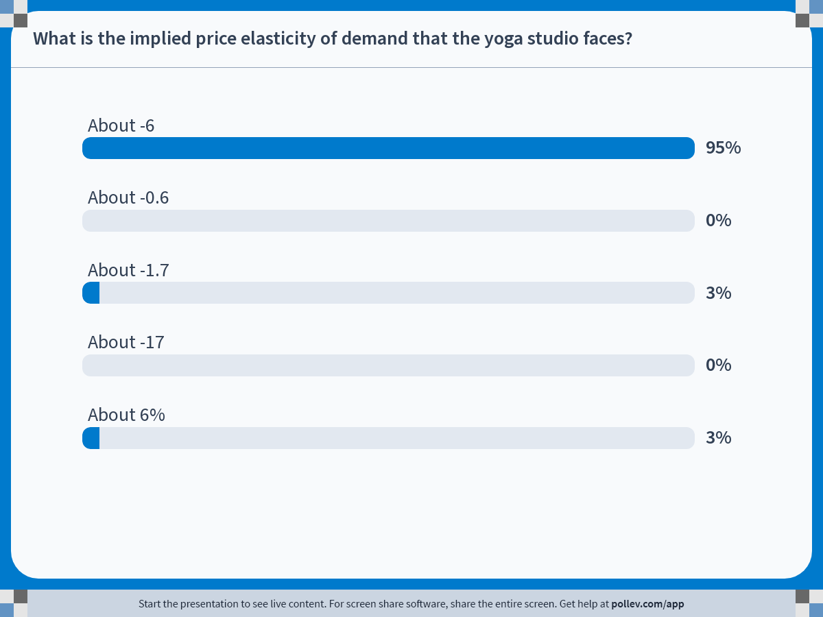
Notes:
Poll Title: Do not modify the notes in this section to avoid tampering with the Poll Everywhere activity. More info at polleverywhere.com/support What is the implied price elasticity of demand that the yoga studio faces? https://www.polleverywhere.com/multiple_choice_polls/i8U7FpeAyYylmHJnQyQis?display_state=chart&activity_state=opened&state=opened&flow=Engagement&onscreen=persist

Slide 7
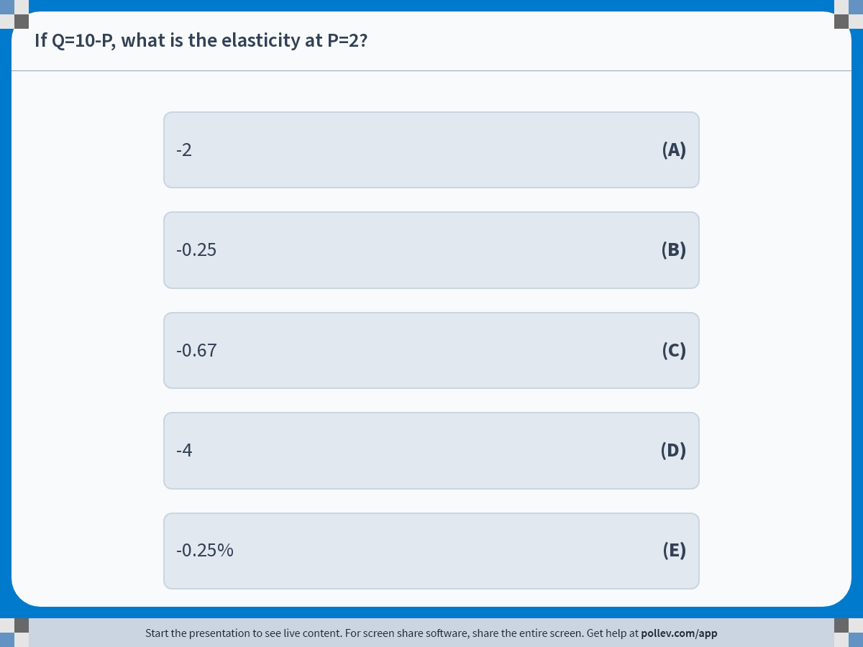
Notes:
Poll Title: Do not modify the notes in this section to avoid tampering with the Poll Everywhere activity. More info at polleverywhere.com/support If Q=10-P, what is the elasticity at P=2? https://www.polleverywhere.com/multiple_choice_polls/xsAr6c0HGhjW6ITPr1oK6?display_state=instructions&activity_state=opened&state=opened&flow=Instructor&onscreen=persist

Slide 8
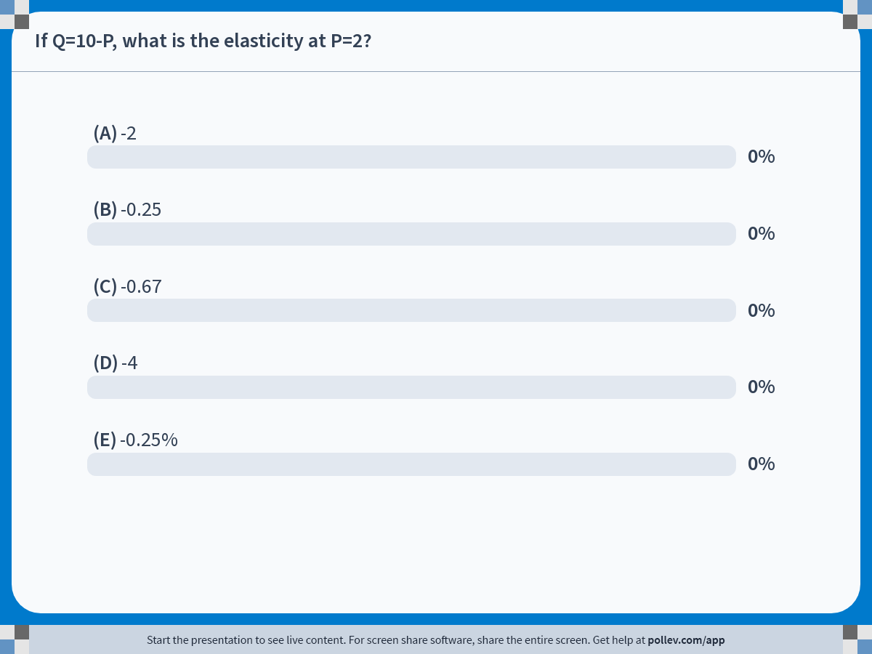
Notes:
Poll Title: Do not modify the notes in this section to avoid tampering with the Poll Everywhere activity. More info at polleverywhere.com/support If Q=10-P, what is the elasticity at P=2? https://www.polleverywhere.com/multiple_choice_polls/xsAr6c0HGhjW6ITPr1oK6?display_state=chart&activity_state=closed&state=closed&flow=Instructor&onscreen=persist

Slide 9
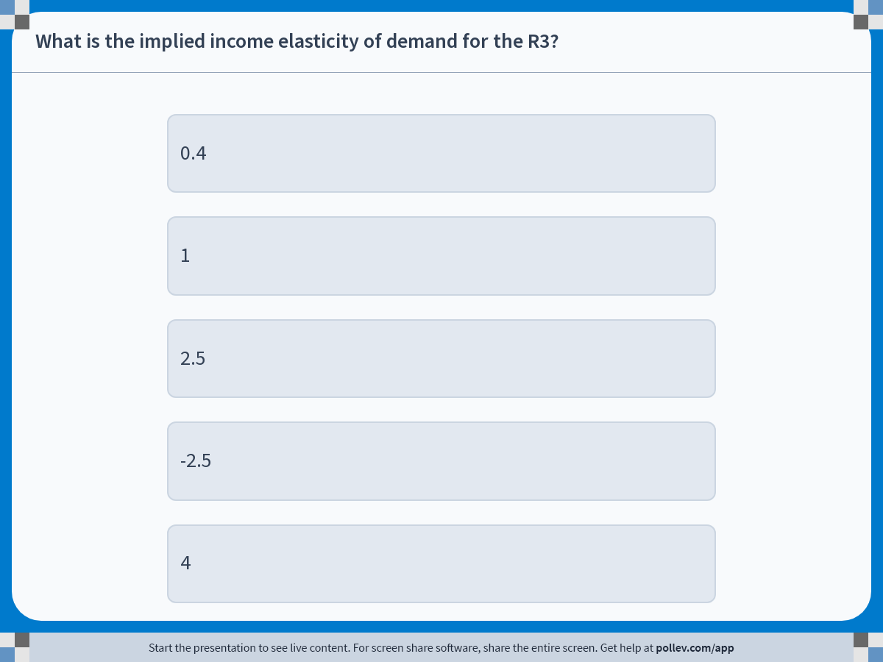
Notes:
Poll Title: Do not modify the notes in this section to avoid tampering with the Poll Everywhere activity. More info at polleverywhere.com/support What is the implied income elasticity of demand for the R3? https://www.polleverywhere.com/multiple_choice_polls/dDWDEU7LWybudBMb6ze0h?display_state=instructions&activity_state=opened&state=opened&flow=Instructor&onscreen=persist

Slide 10
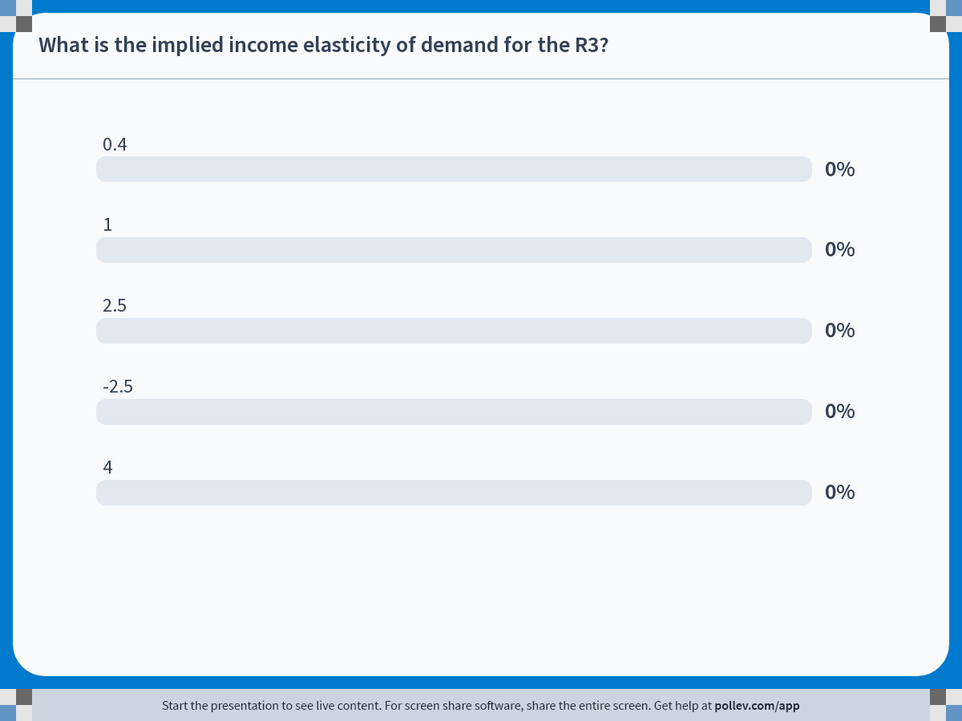
Notes:
Poll Title: Do not modify the notes in this section to avoid tampering with the Poll Everywhere activity. More info at polleverywhere.com/support What is the implied income elasticity of demand for the R3? https://www.polleverywhere.com/multiple_choice_polls/dDWDEU7LWybudBMb6ze0h?display_state=chart&activity_state=closed&state=closed&flow=Instructor&onscreen=persist

Slide 11
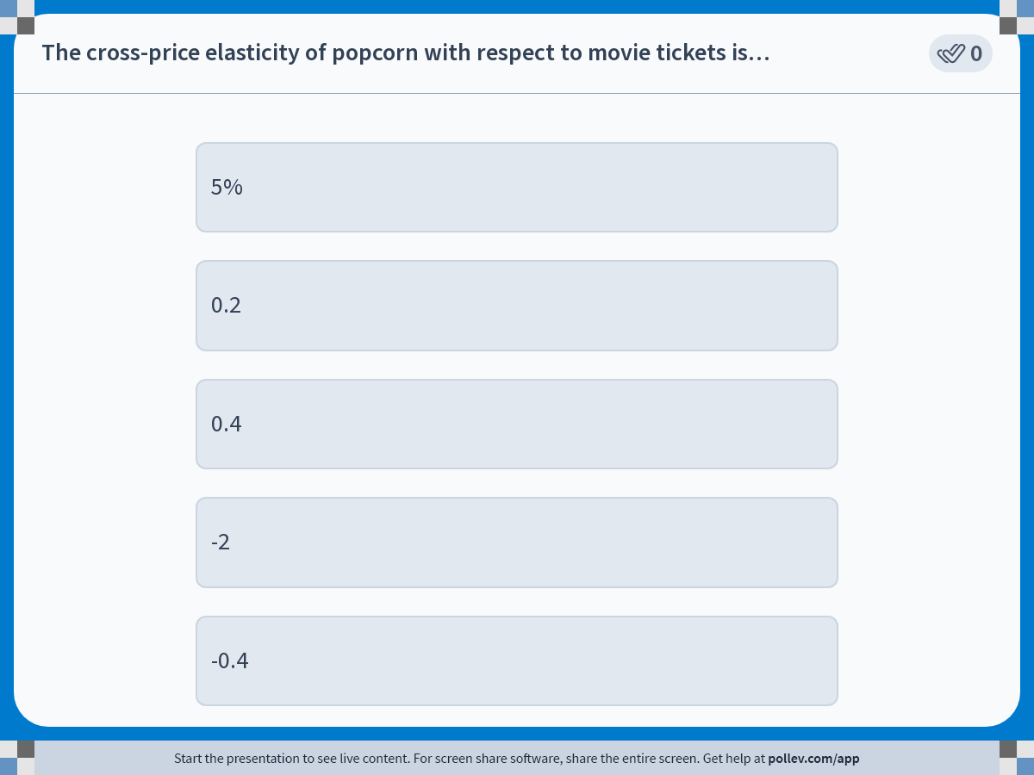
Notes:
Poll Title: Do not modify the notes in this section to avoid tampering with the Poll Everywhere activity. More info at polleverywhere.com/support The cross-price elasticity of popcorn with respect to movie tickets is… https://www.polleverywhere.com/multiple_choice_polls/wJOehuhwslqtDCkgOKtHP?display_state=instructions&activity_state=opened&state=opened&flow=Engagement&onscreen=persist

Slide 12
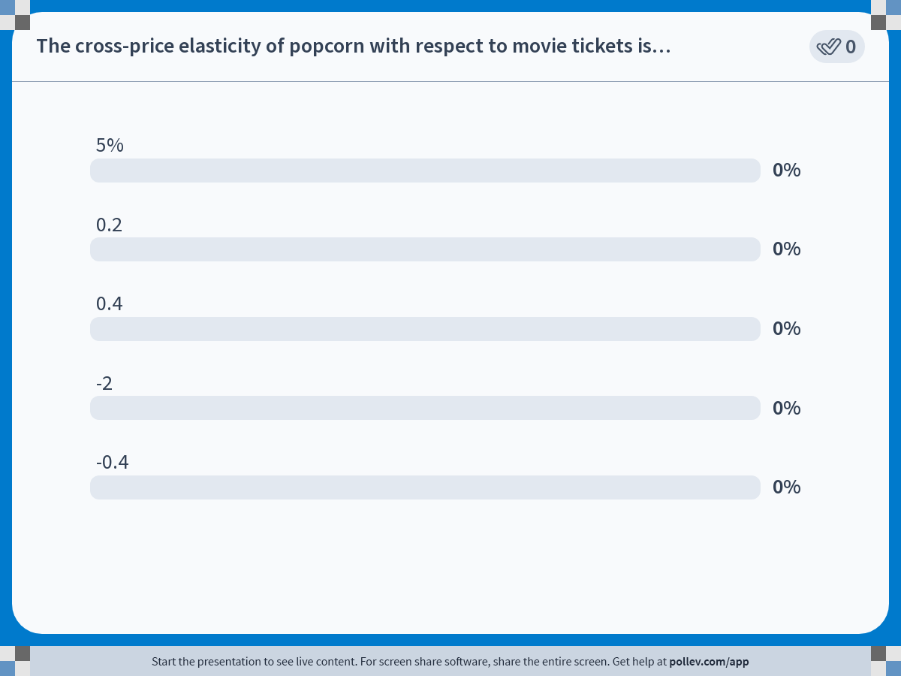
Notes:
Poll Title: Do not modify the notes in this section to avoid tampering with the Poll Everywhere activity. More info at polleverywhere.com/support The cross-price elasticity of popcorn with respect to movie tickets is… https://www.polleverywhere.com/multiple_choice_polls/wJOehuhwslqtDCkgOKtHP?display_state=chart&activity_state=opened&state=opened&flow=Engagement&onscreen=persist

